Slide 1

IR control Catch Omibox
Yahboom

Slide 2
1
2
3
4
5
Learning
goals
Search for
blocks
Combine
blocks
Experimental
phenomena
Preparation
程序编程
Tencent

Slide 3
1
Preparation-1
1. The position of the button in the robot car
2. Learn how to use button graphically programming block

Slide 4
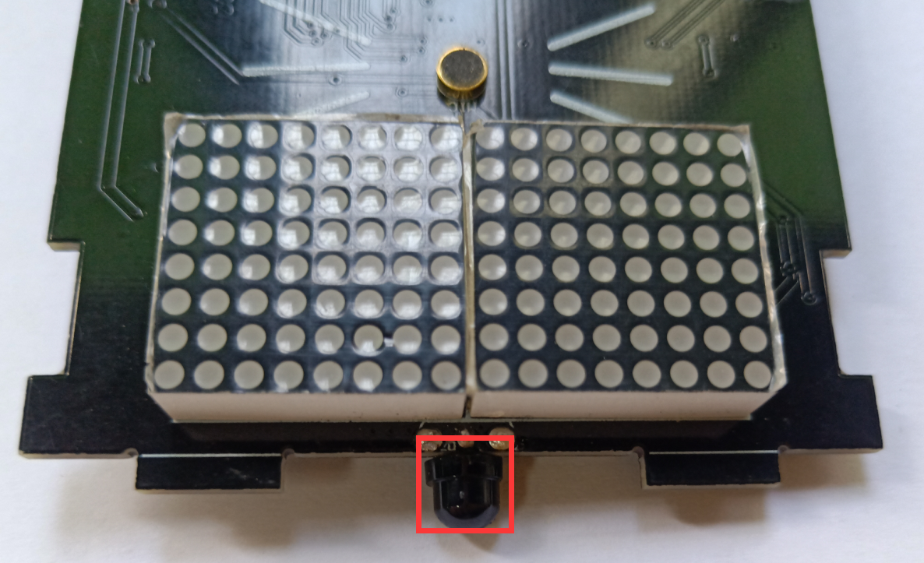
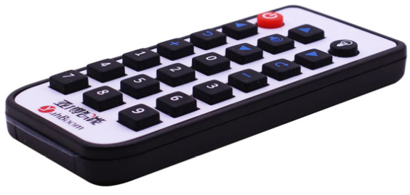
1
Preparation-2
As shown on the left figure above, the infrared receiver on the Omibox programmable robot circled by the red wire frame on the left.
As shown on the right figure above, infrared remote controller.
The infrared remote controller is used to send a signal to the infrared receiver, and the infrared receiver is used to receive the signal sent by the infrared remote controller.

Slide 5





















2
Learning goals
In this lesson, we mainly learn how to make the infrared remote controller to control the following functions of the Omibox programmable robot by programming.
Advance
Back
Turn left
Turn right
Spin left
Spin right
Whistle
White light
Red light
Green light
Blue light
Clip close
Clip open
Clip put down
Play 《Ode》
Play 《Little star》
Clip lift up
music pattern
house pattern
Boat pattern
Turn off lights

Slide 6
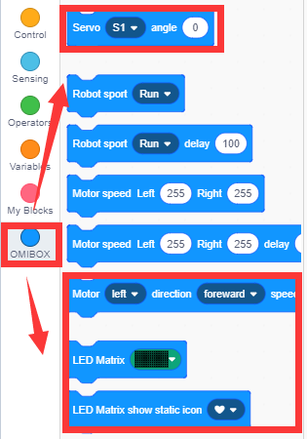
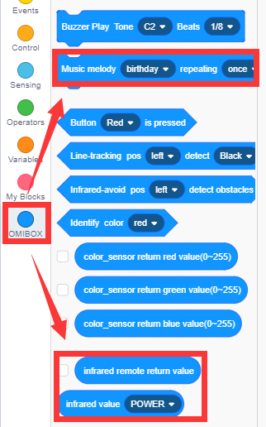
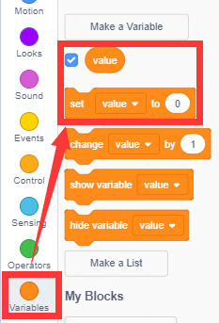
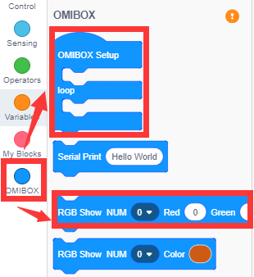
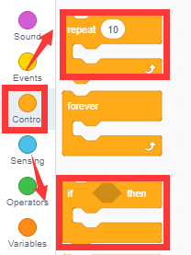
3
Search for blocks
The following is the location of the building blocks required for this programming.

Slide 7
4
Combine blocks
Please see the IR control Catch Omibox.sb3 file for this experimental procedure.
!!!Note: When use servo in the first time,we need to remove the gear on the building block servo and download the program to micro:bit. Next, turn on the power of the robot, wait for the building block servo to turn to the initial position. Then ,turn off the power. Finally, we need to install the gear on the building block servo. In initial status, clip is put down and close.

Slide 8
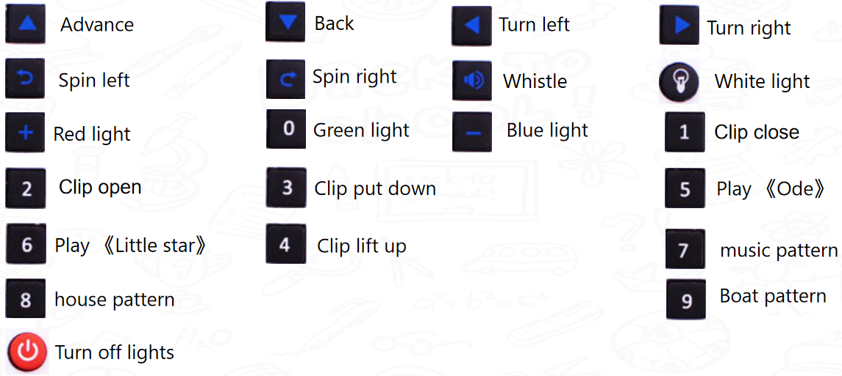
5
Experimental phenomena
After the program is uploaded, open the power of the robot car, scroll and display the eyes on the dot matrix screen. The infrared remote controller corresponds to the following functions.

Slide 9
Inspire Creativity Embrace Innovation
Thank you!!!
Yahboom

